Slide 1
Escif, greece
2023
Personal assistance in slovenia
Špela Šušteršič, Slovenian paraplegic association

Slide 2
Personal assistance before 2019
– as programme
from 2003 to 2018: personal assistance for people with disabilities was organised by Ministry of social affairs through public tender
Programme was implementet by disability organizations
it was financed by the Ministry of social affairs and FIHO foundation (foundation for financing disability and humanitarian organizations)
It was 34 disability organizations, they provided personal assistance only for their members
the programme included 1.200 people with disabilities and 450 employed personal assistants (PA)
people can get personal assistance only for 8 our per day, 40 hours per week
Budget was 6.000.000 million EUR

Slide 3


there wasn't enough money to include all the people with disabilities into the program
employees did not receive enough payment for their work
organizations had to collect donations for the implementation of personal assistance
many people with disability were on the waiting list for a long time (sometimes years)
there was no replacement for the absence of personal assistants
there were enough candidates for the job of a personal assistant
single entry point for the type of disability
family members volunteered to help.
Notes:
rtghfgdf

Slide 4
Personal assistance since 2019
– legal right
financed by Ministry of Social affairs; the price per hour is 15,00 EUR
users of personal assistance participate with half of their budget for help due to their disability status, which is specified in the law governing pension and disability insurances (86 EUR, 173 EUR or 248 EUR when somebodies condition requires more help)
107 different providers with different views what personal assistance should be ( small private companys, small association witch were establish only for personal assistance)
4000 people with disability and 8000 personal assistants (4000 family members)
The budget for this year is 180.000.000 million EUR

Slide 5
Who can get personal assistance?
The right to have personal assistance can be acquired by people who belong to one of the following categories:
people with mobility impairments (because of injury, illness, ….),
people with neurological diseases or conditions,
people with sensory disabilities (blind and partially sighted, deaf and hard of hearing).
minimum 30 hours per week, up to 24/7 assistance

Slide 6
Personal assistance can be provided to people who:
need help in carrying out activities related to independent personal and family life, integration into the environment, education and employment
have a permanent residence in the Republic of Slovenia
are between 18 and 65 years old
live or would like to live in an independent household or live outside of full-day institutional care or
need help with communication

Slide 7
Types of personal assistance:
personal care
  from basic personal care to help with aspirations, 24/7 monitoring, catheterization or other medical care
help in the household with domestic work and other similar help
accompany or help through presence
help at the workplace and in the educational process
help with communication

Slide 8
Communication allowance
This right that can be granted to a deaf, blind or deaf-blind person who only needs help with communication and complements personal assistance services.
The beneficiary of the communication allowance can decide to:
apply for personal assistance up to 30 hours per month or
money compensation of 173,56 EUR

Slide 9
Procedure to get personal asisstance
a request for personal assistance is submitted at the Social Work Centre (documentation explaining why help is needed and the type of disability - proof of disability is required)
a two-member commission assesses the needs and approves the number of hours of personal assistance (questionnaire, points)

Slide 10
How personal assistance work in practice:
after choosing a personal assistance provider, a person can start planing assistance with the help of coordinators provider
once a month a person with disability plan personal assistence with coodinator employed at provider (schedule)
PA have to register online their presence at work
Ministry controls if PA were registered accordance with the plan (web application)
provider send monthly bill to Ministry, they check and pay once on month for all hour of personal assistance
once a year annual report to Ministry

Slide 11
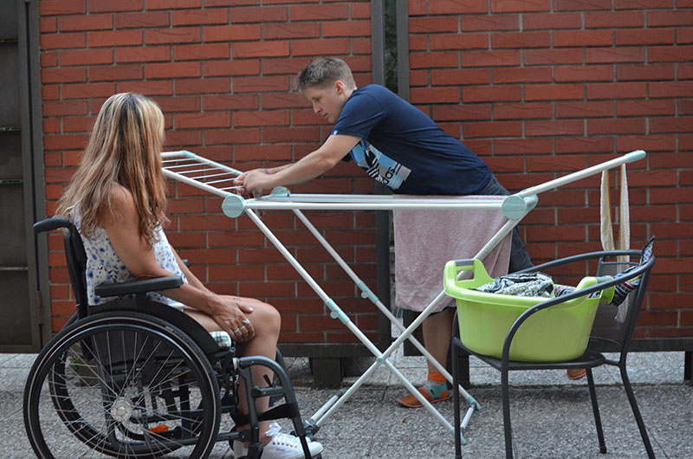
Who can be a personal assistant?
an adult person who has not been legally convicted of a criminal act
they can as well be (close or more distant) family members of the person with disability (limited to 2 assistants of that type)
has completed the basic training
  Payment:
  Close to minimum wage in Slovenia (1.203,36) or 1.226,82 EUR

Slide 12


not enough candidates for the work of PA
family members do not want to volunteer to help
employees do not receive sufficient payment for their work
to many different providers (107)
PA work with people alone in their home , they do not have the support of a team
PA do not get enough help from other services to help them maintain business relationship with the person they are taking care of
providers do not get enough financial resources to cover all the costs of personal assistance from the Ministry
People end providers are outplaying the system for financial benefits
people with disabilities live more active lives, they are not allone at home, we can see them outside
more included userses
they can get or use 24/7 assistance
replacement of PA when they go on holidays
Notes:
rtghfgdf

Slide 13
Thank you for your attention
☺

