Slide 1
New to spinal cord injuries?
An interactive online course
Emelie Axwalter
hej@ryggmargsskadecentrum.se

Slide 2
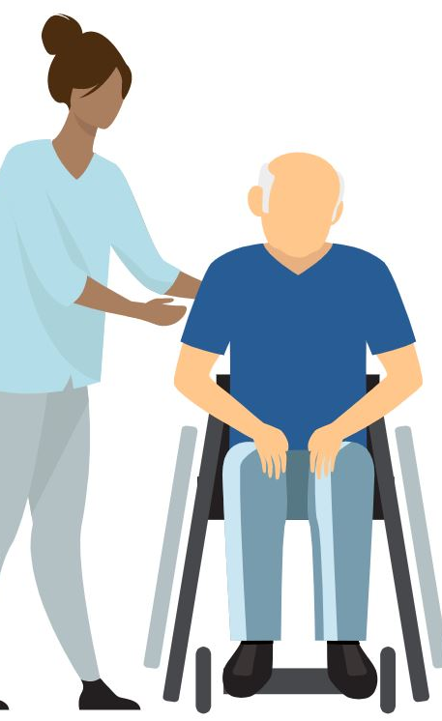
Why did we make the course?
Care and rehabilitation units and personal care assistant companies expressed a need for education as new staff is being employed continuously.
They wanted a course that is
  accessible 24/7
  easy to understand
  providing a holistic approach.
Notes:
Around the clock
For people without prior knowledge
So everything surrounding Acquiring SCI, from initial crisis to a good and functional every day life

Slide 3
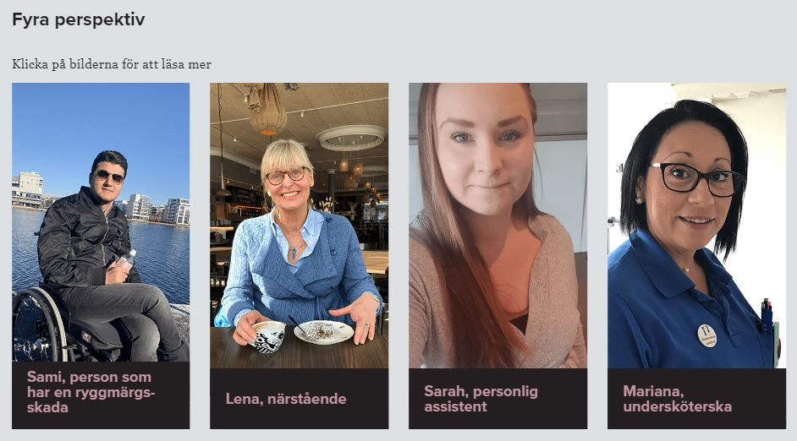
Target groups
Notes:
The primary target group was the ones who ”ordered it”:
Personal care assistants
Care personell, especially assistant nurses.
It can greatly benefint others as well, for example
Persons with a spinal cord injury and their close ones. In the beginning of the course a person from each target group share their perspective.

Slide 4
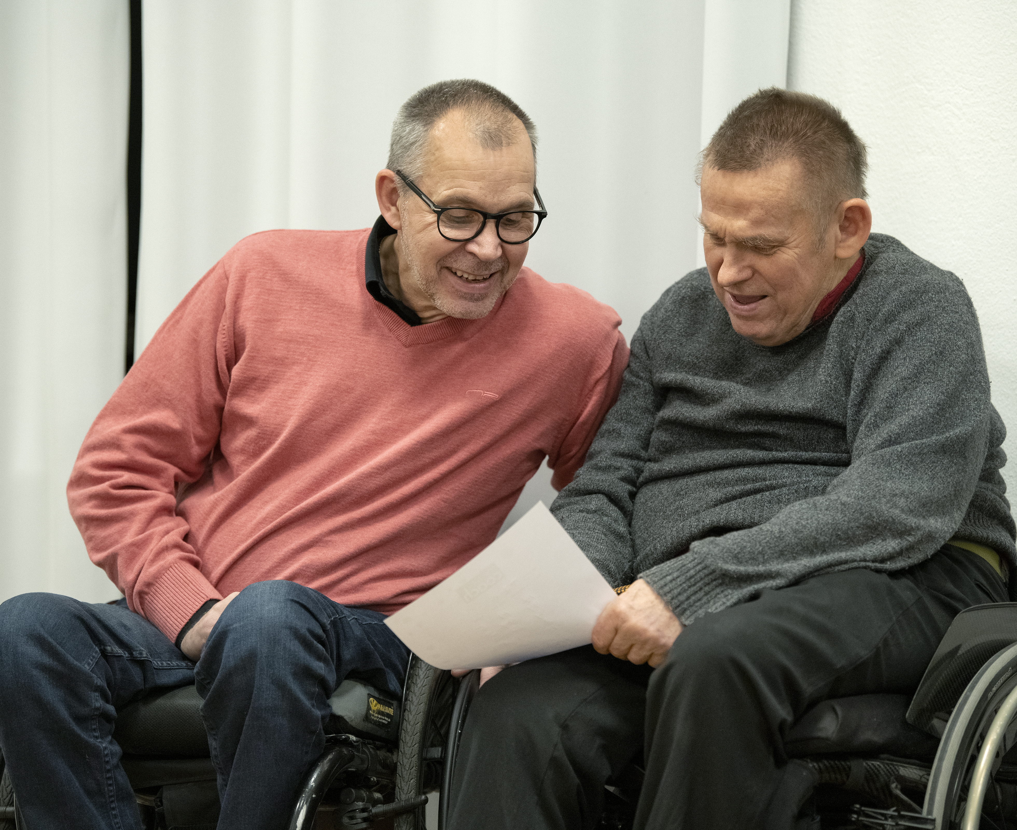
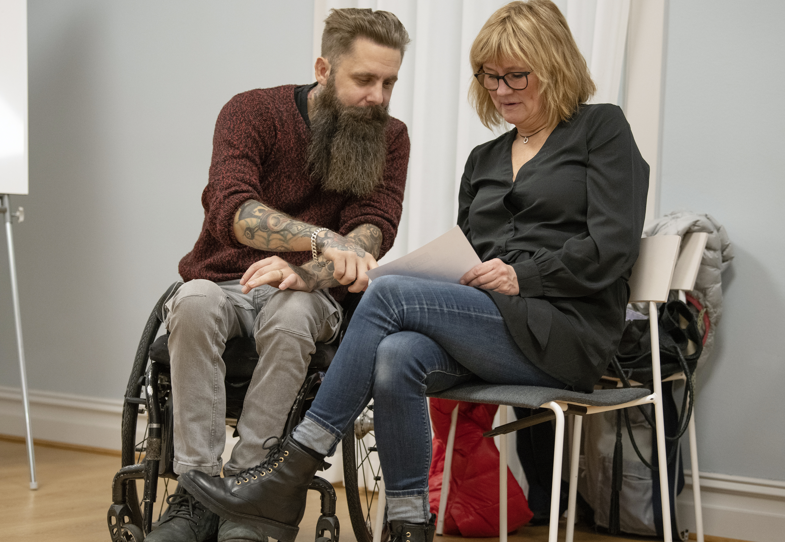
The making of the course
Researching existing online education
Interviewing focus groups of people living with SCI and personal care assistance companies
Our experienced SCI physiotherapists and senior physician writes the content
Our consultant in plain language edits the content
Experts and plain language consultant makes final adjustments together
An e-learning agency designs and code the course in collaboration with us
We do a user experience test before finalising the design
Publication of the course
Notes:
Target groups were involved from the start.
It’s written by experts, and edited by a plain language consultant to make it easy to understand for people who might not have´any medical, paramedical or care education from before.

Slide 5
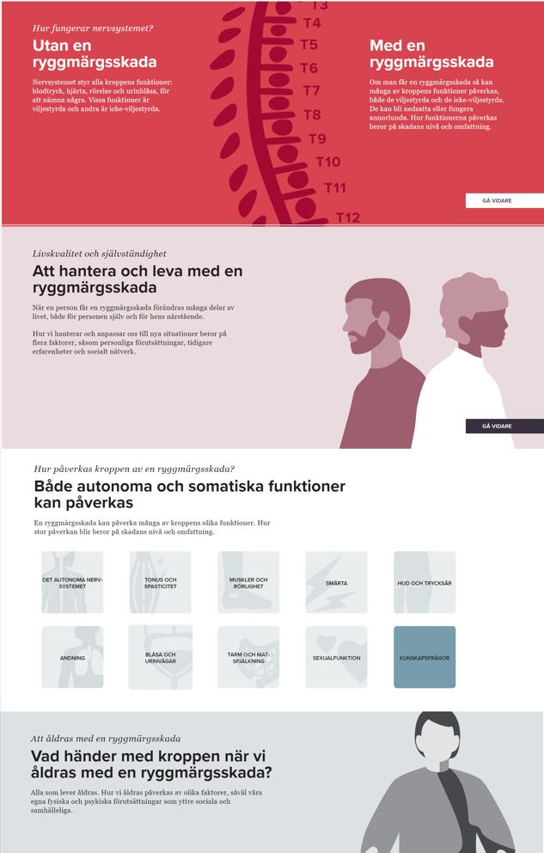
Participation this far
About 530 participants, most come from care and rehabilitation units.
It’s being used in the Swedish Association for Survivors of Accident and Injury’s peer coaching program.
Notes:
The Swedish ESCIF member
The peer coaching program was presented last year, I believe.

Slide 6

Free access for consumer organisations soon!
Update first, then
SCORM package (file format)
Translation
Notes:
Right now we are working on an update. When it’s done user organisations will be able to access the course freely.
It’s in Swedish – so you will have to translate it yourself.
Nerdy code stuff: It’s a SCORM package, which means you have to be bale to unpack the code, for example by having access to a learning management system (LMS) where you can put it. We recommend talking to your web manager about it.
It is an international standard for e-courses. If your course is published in the SCORM format, you can be sure that almost any learning management system (LMS) will recognize it.

Slide 7
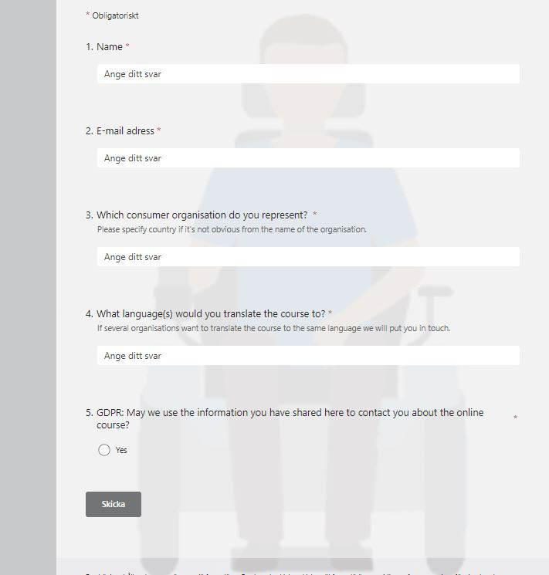
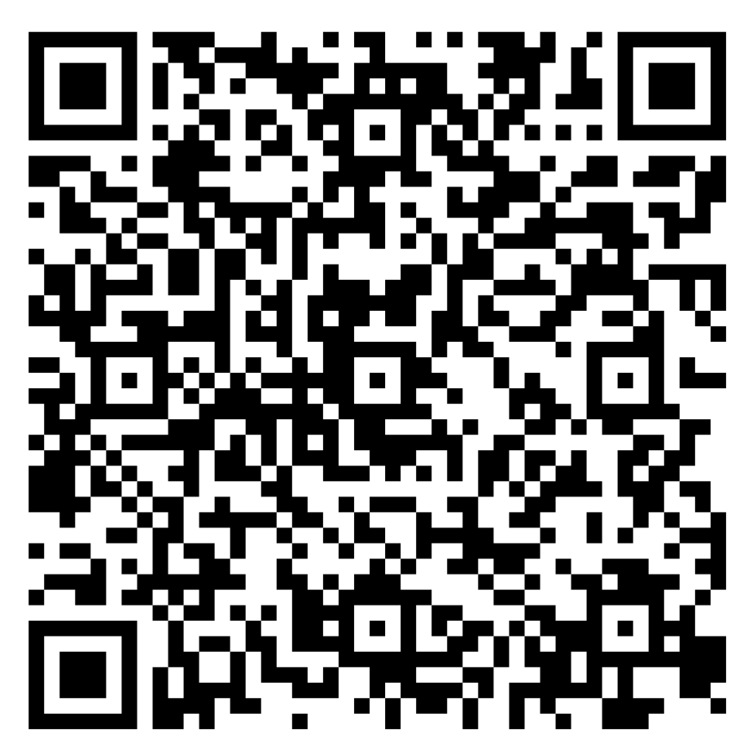
Sign up if you are interested!
Notes:
https://forms.office.com/Pages/ResponsePage.aspx?id=VaJi_CBC5EebWkGO7jHaX5T87hACmZNMhEa9KylqmpFUNDBIT0xVUURMNDZZUjA2UkE3SE5LUzJJWi4u

Slide 8
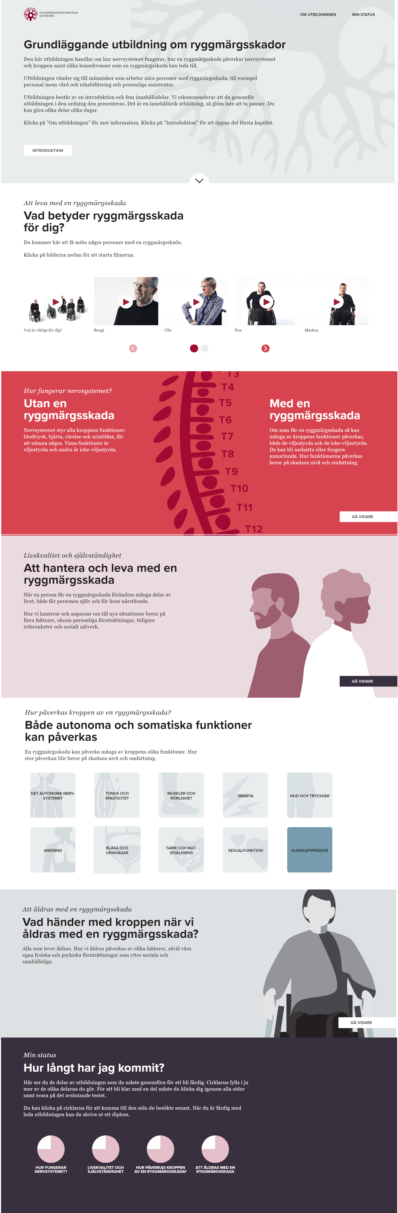
Course contents
1. Introduction to the course
2. Perspectives on living with SCI
3. The nervous system
4. Quality of life and independence
5. Complications
6. Aging with a SCI

Slide 9
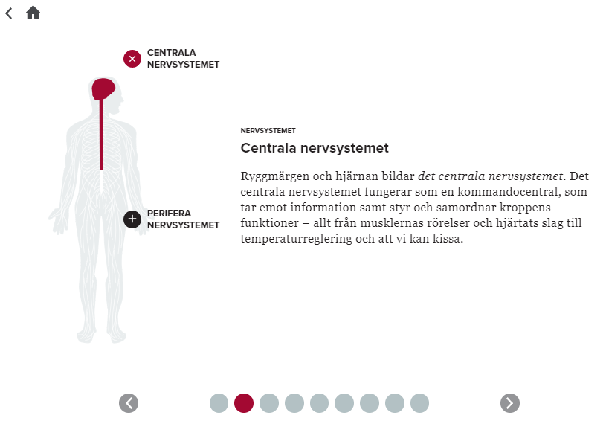
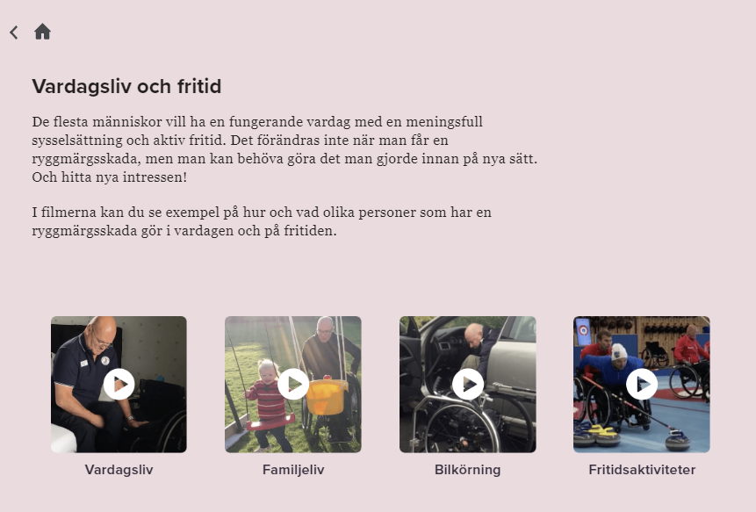
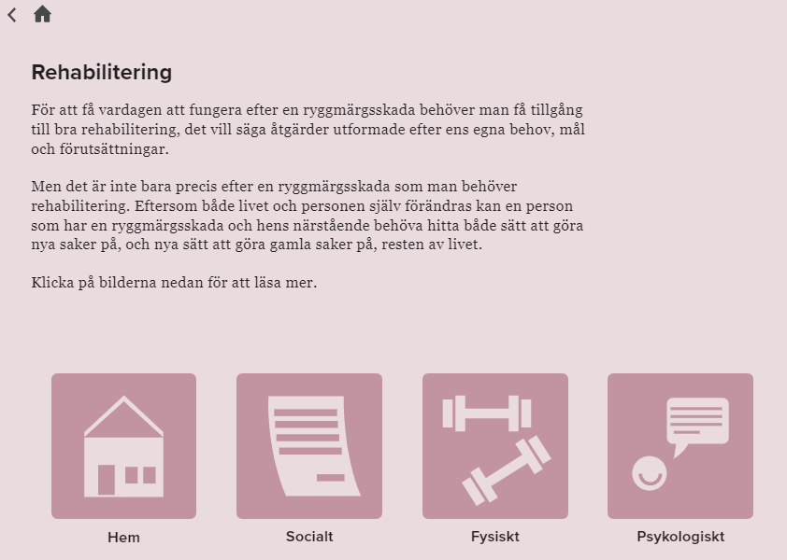
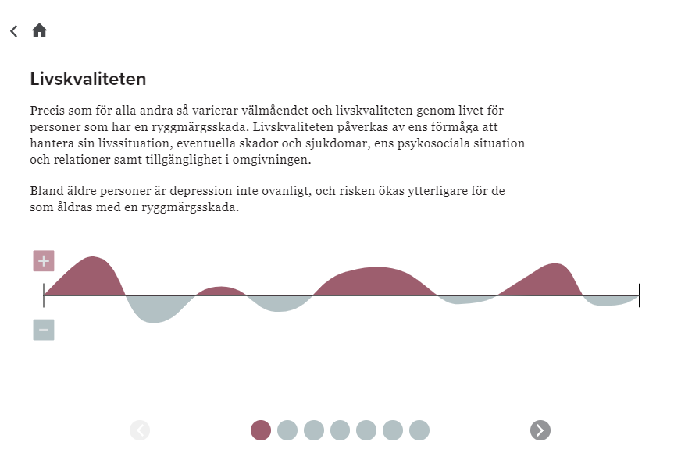
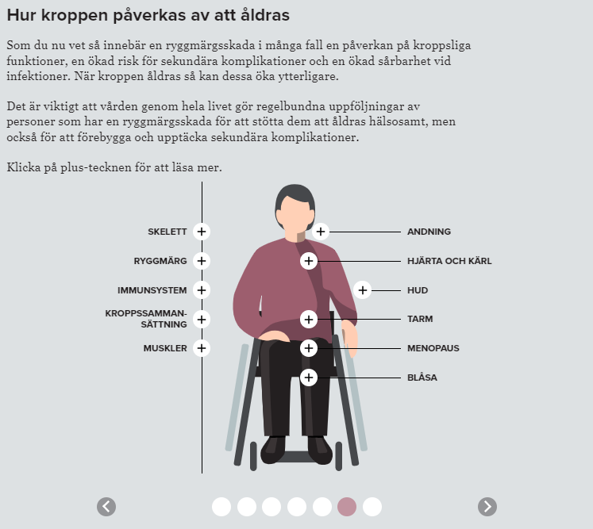
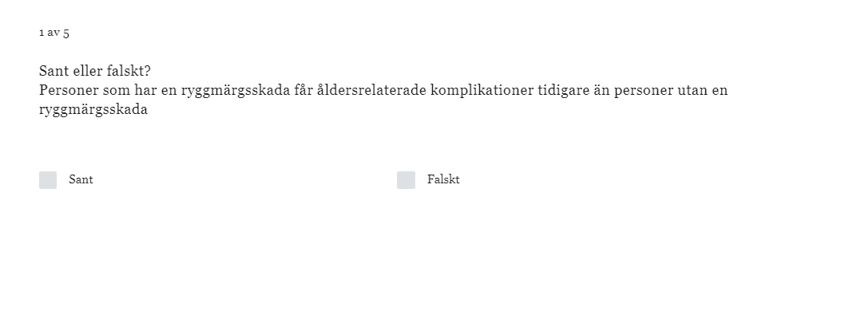
Course contents
Notes:
Text, illustrations, animations, videos, quizzes
Four quizzes = diploma

Slide 10
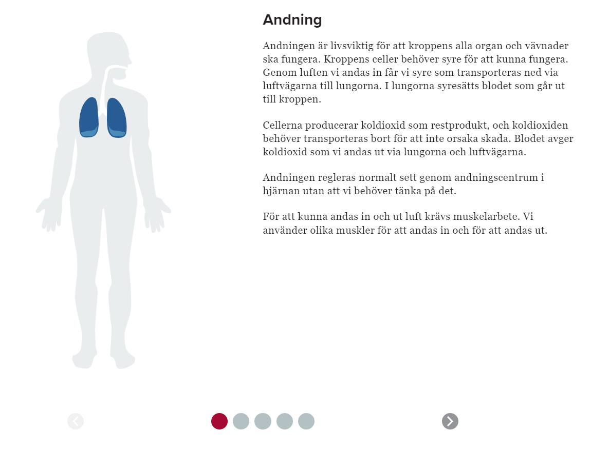
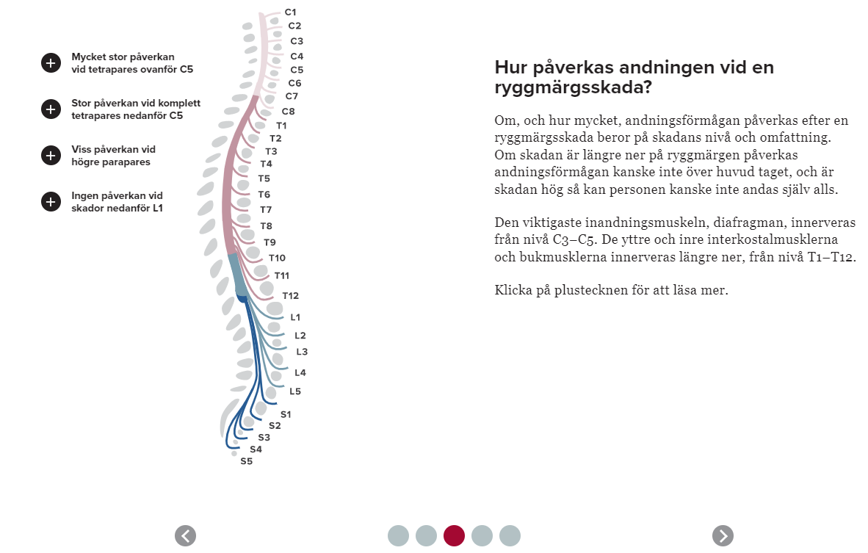
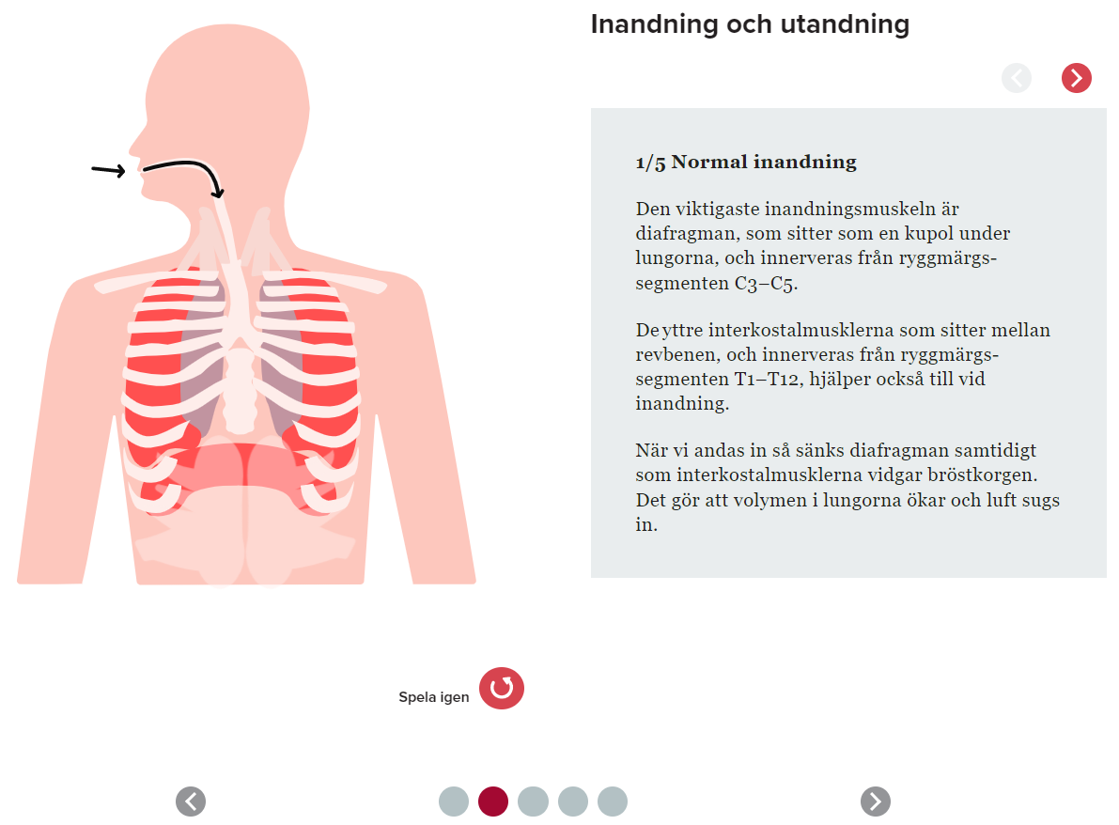
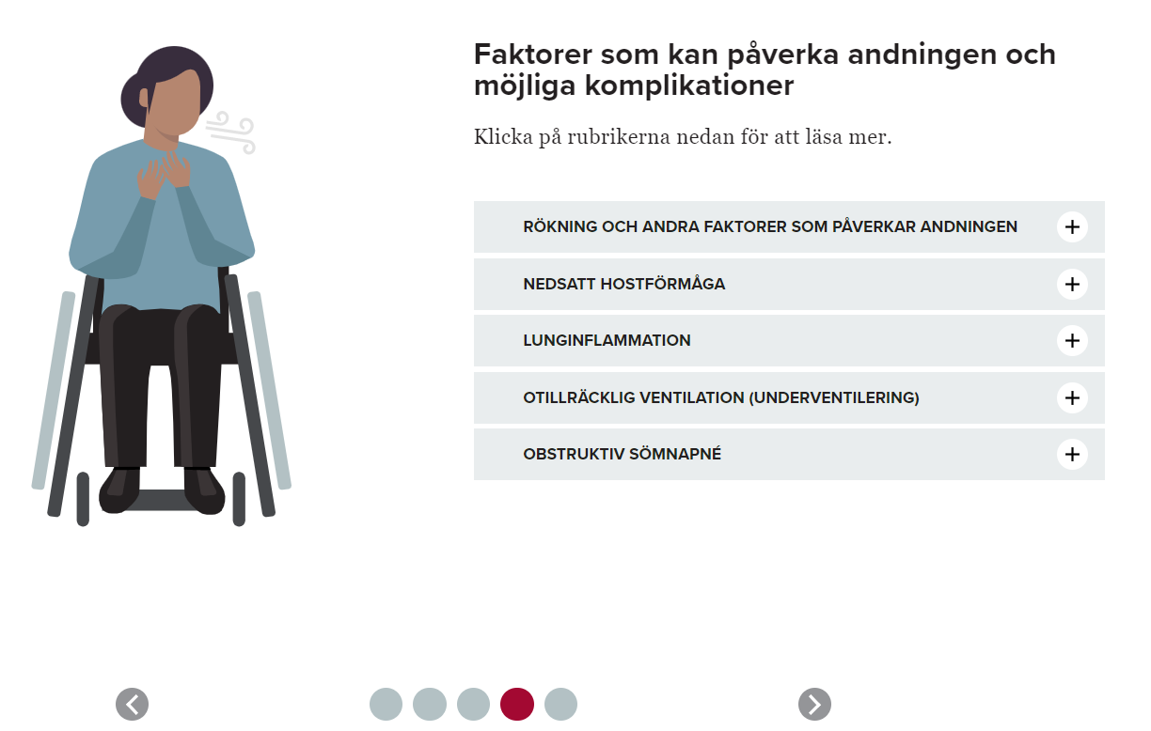
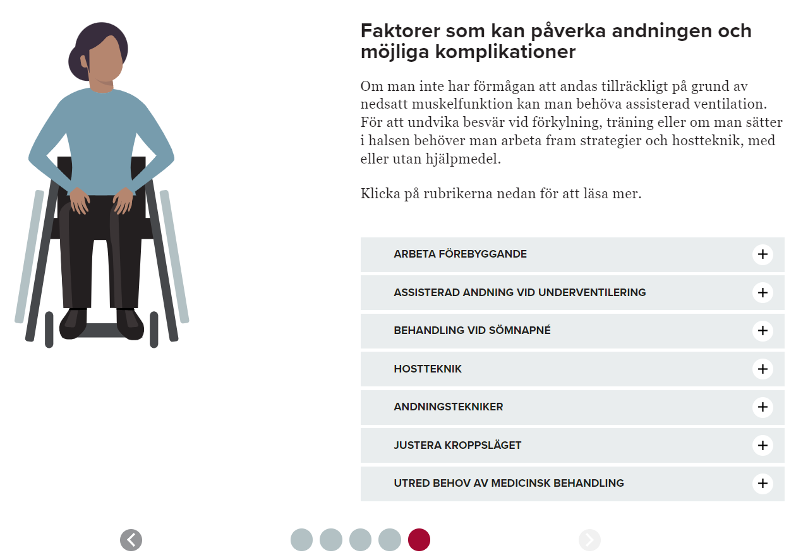
A more in-depth example: Breathing
About
Animations of how breathing functions
(or don’t)
SCI impact
Preventative measures
and treatments
Influencing factors and complications
Behandling och åtgärder

Slide 11

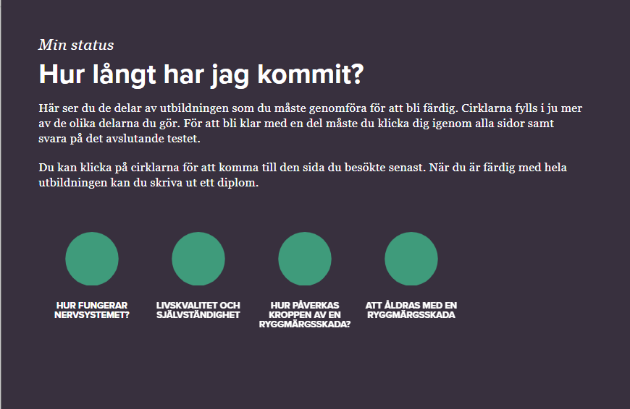
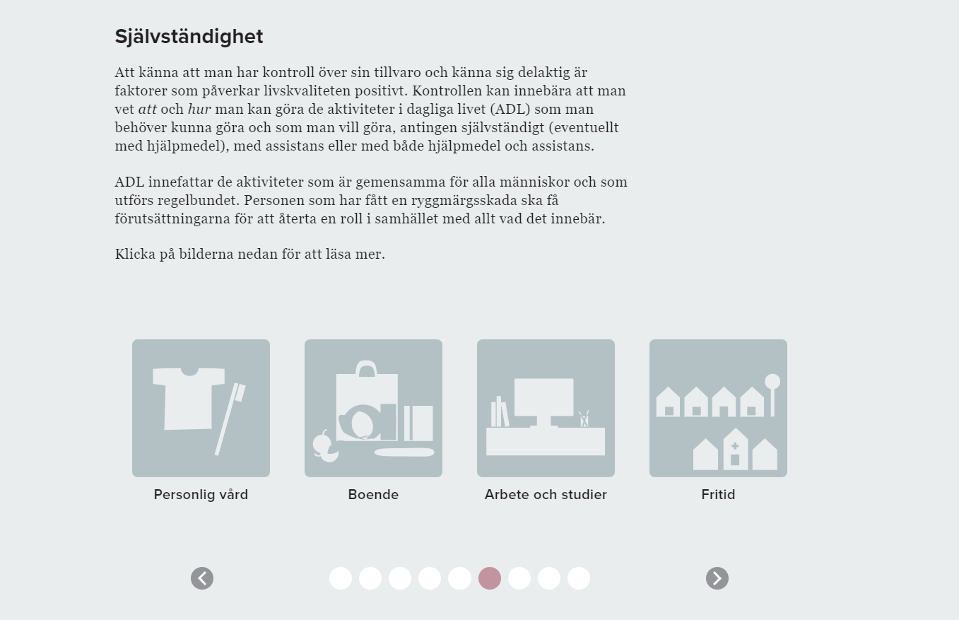
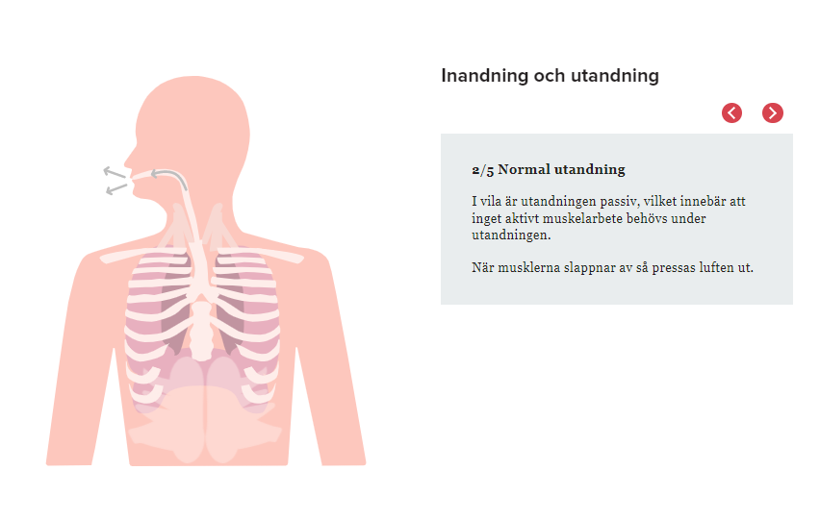
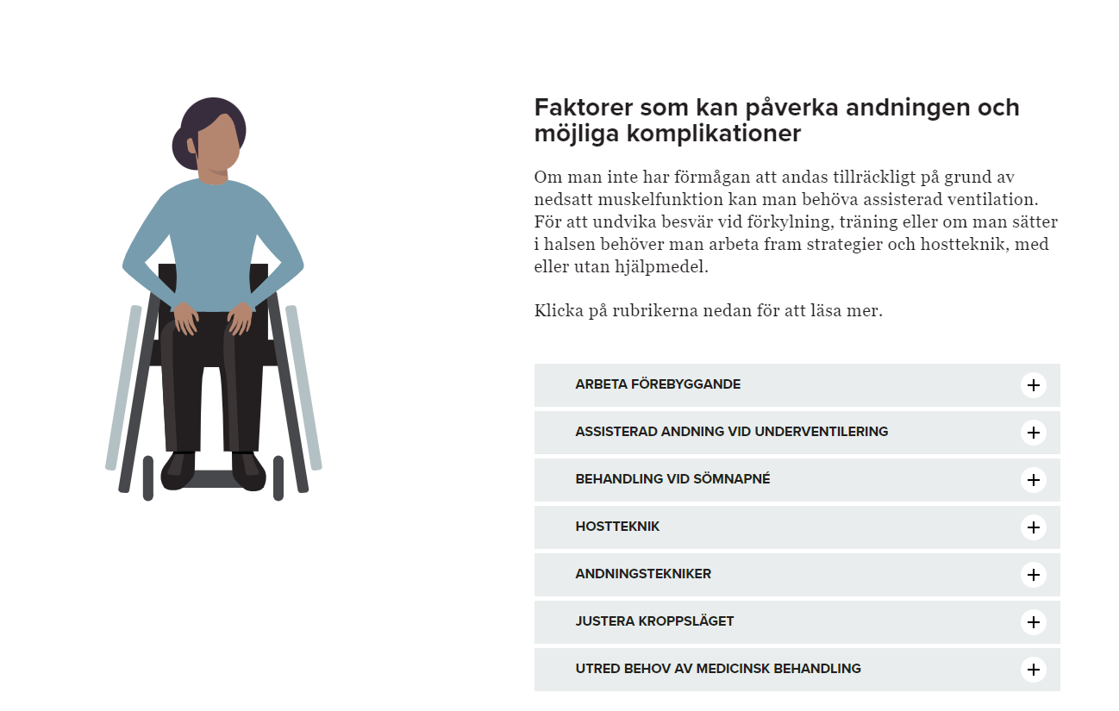
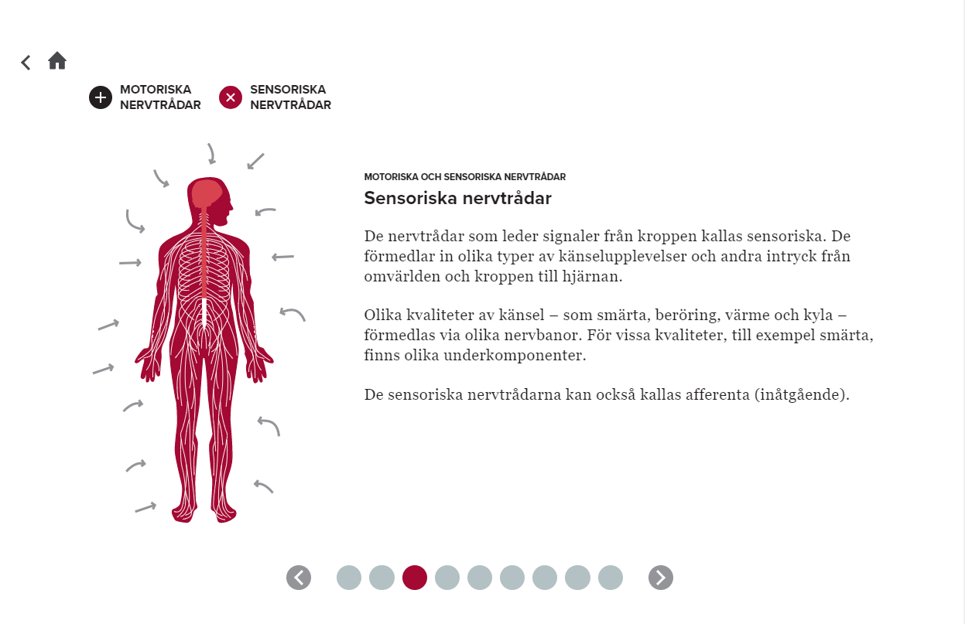
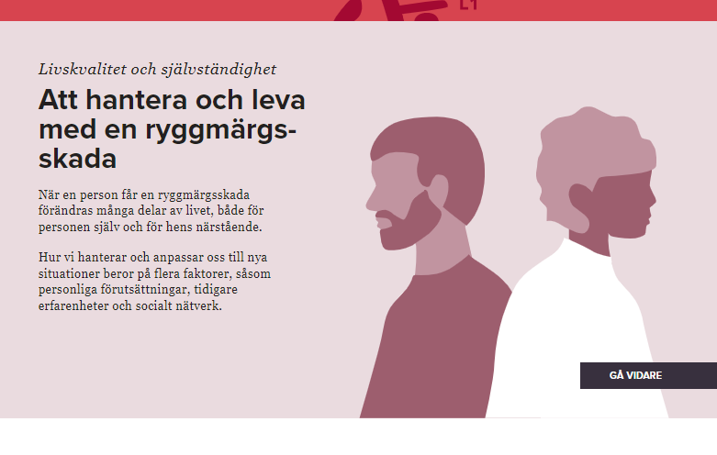
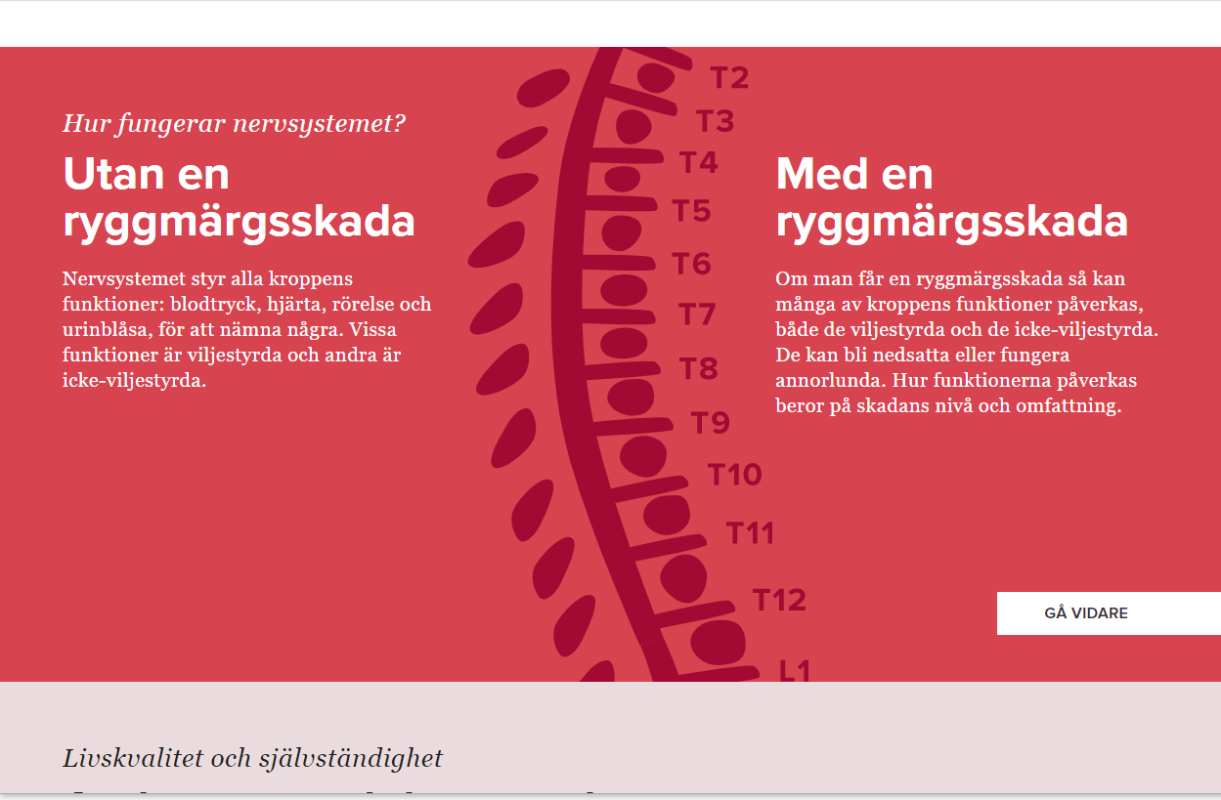
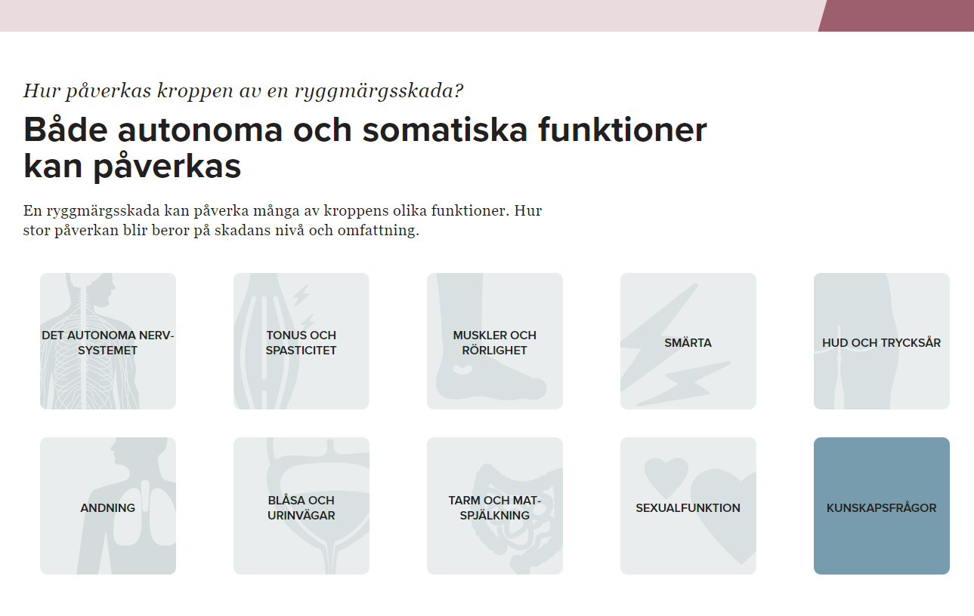
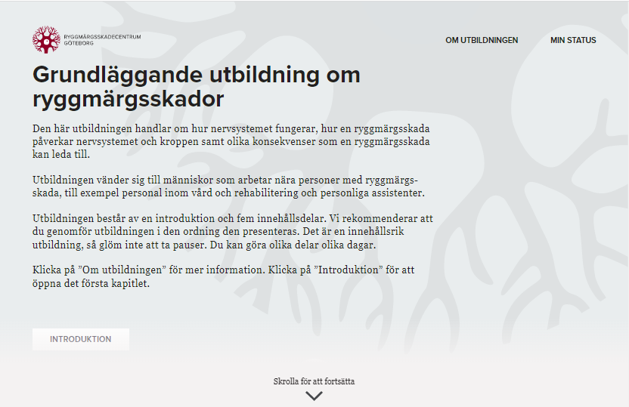
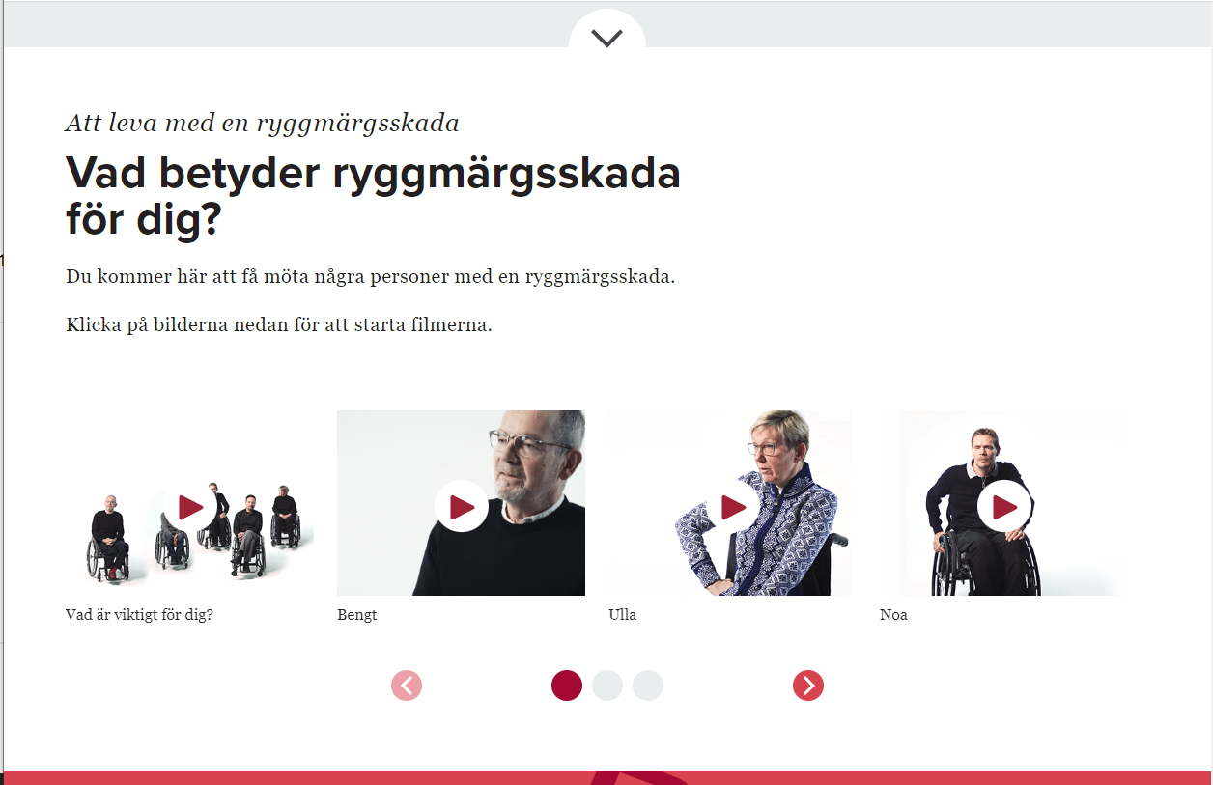
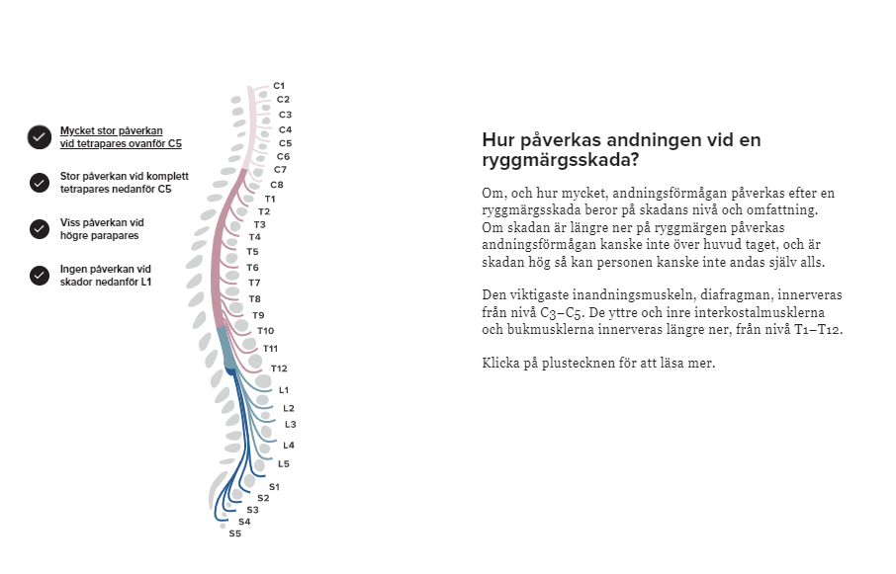
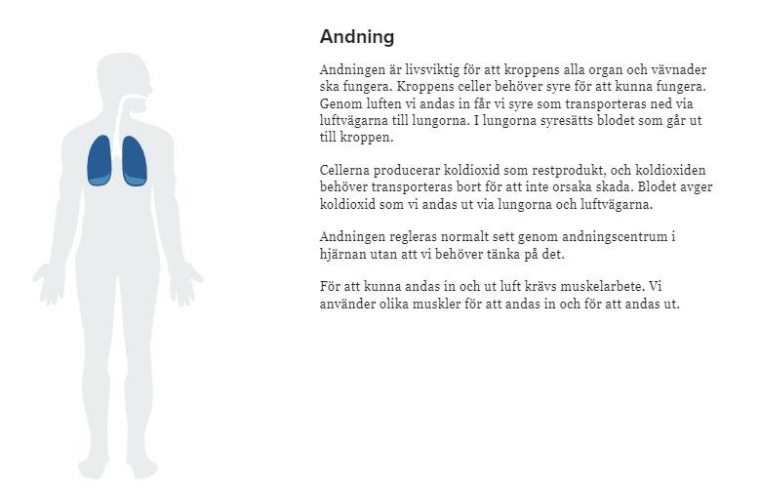
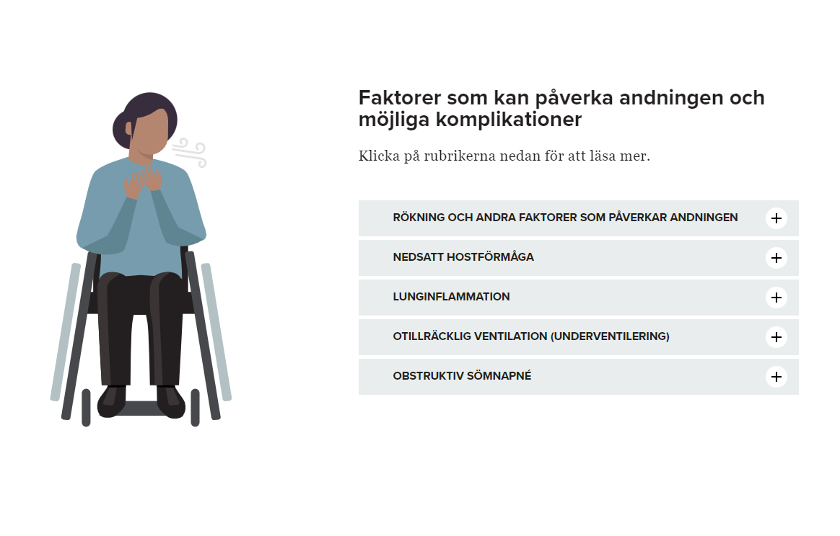
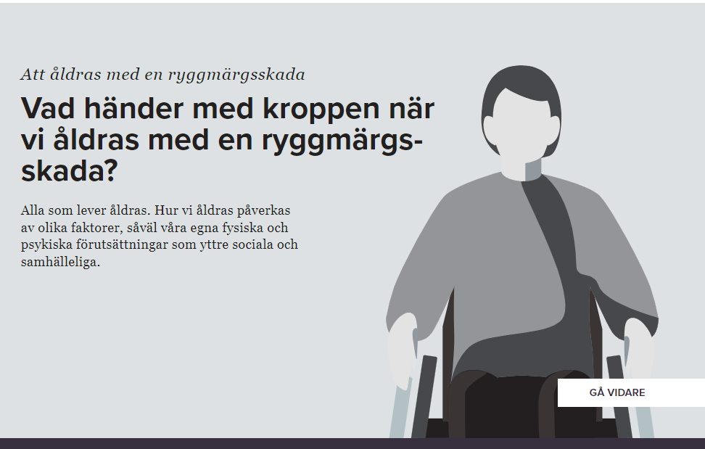
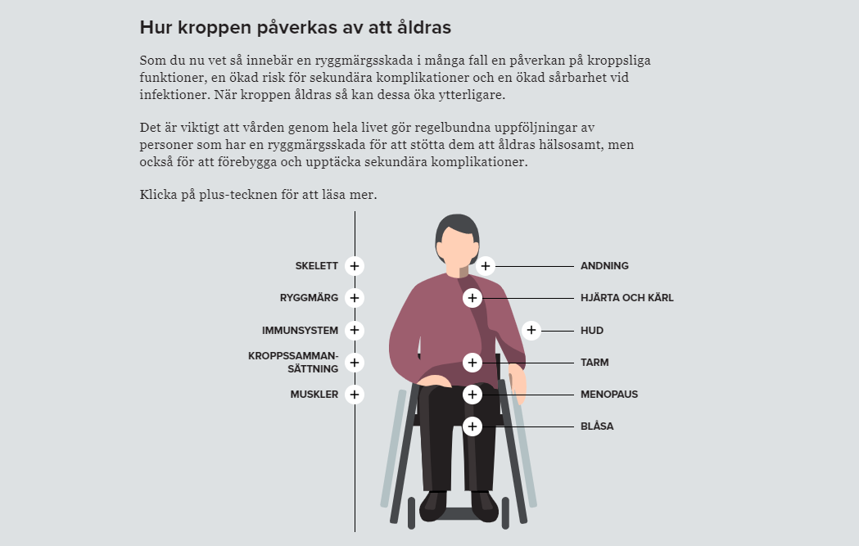
Notes:
0. First chapter: about the course, the for perspectives.
1. Second chapter: Living with a SCI, Different persons with lived experience share what it means to live with a SCI and what’s important to them
2 + 3. Third chapter: About the nervous system, with and without an SCI.
4 + 5. Fourth chapter: Quality of Life and independence, psychological and emotional aspects.
6: Fifth chapter: in depth about different complications, in the autonomic nervous system, spasticity, mobility, pain, pressure ulcers, breathing, bladder, bowel and sexual function.
7–11: Breathing: About breathing, animations for normal breathing, laboured breathing and coughing.
12–13: Aging with a spinal cord, how it affects the body
14: Overview of progress, if you’ve done everything you get a diploma.

