Slide 1


Accessible Ljubljana
SLOVENIJA
Thessaloniki, June 2nd, 2023
Mirjam Kanalec

Slide 2
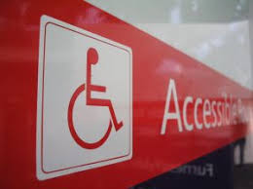
Accessibility is not only related to PWD, but dictates how to facilitate access, entry and use of tourist facilities and services for all people in the direction of independence.
accessibility needs vary depending on the type of disability
physical access
  transport
  accomodation
  sightseeing
  restaurant facility
  Streets, beaches
Access to information

Slide 3

Tourism, accessible tourism
Tourism is an economic activity. It is based on people traveling for leisure, entertainment or business. A tourist can be a visitor from a neighboring village or a foreigner who visited our place for natural or cultural attractions, relaxation, entertainment or prestige.
Accessible tourism is a set of services, facilities and infrastructure that enables people with disabilities, as well as people with long-term health problems and the elderly, or all guests, to enjoy their vacation without obstacles and problems.

Slide 4
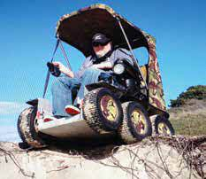
Charasteristics of accessible tourism, Economical view
Big market size (PWD, elderly, people with long term health problem, …)
More than one time per year
Out of the highest sezone
Accompaning persons
Developing the local tourism
Satisfied coustumers are coming back
They spend more time on average
They spend more money on average

Slide 5
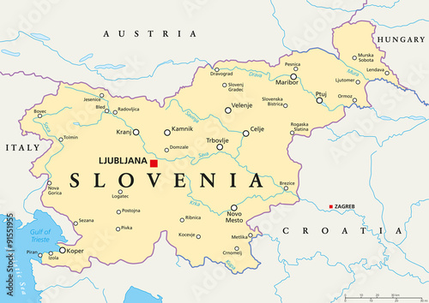
SLOVENIA
Capital city: Ljubljana
2 mio people
20.000 km2
Ex Jugoslavia republic, 1991
212 municipalities
EU
Euro

Slide 6
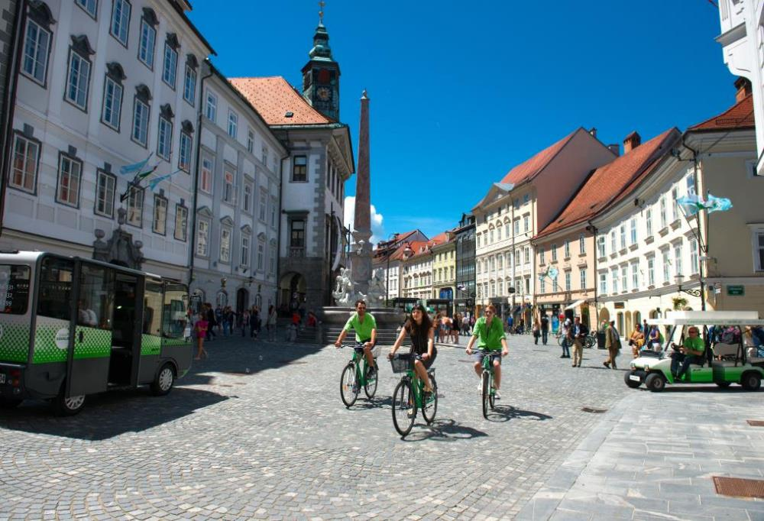
State and local communities at assuring accessibility
The Constitution of the Republic of Slovenia
UN Convention on the Rights of Persons with Disabilities ratified in April 2008
The protection of persons with disabilities and their rights governed by the laws of the State. (ZIMI, API, strategija o dostopnosti, Strateško načrtovanje dostopnosti)
Local communities (municipalities) by legislative duties and self-imposed measures/activities contributing significantly to a friendly living environment accessible to all.
photo: Nea Culpa, source: Tourism Ljubljana

Slide 7
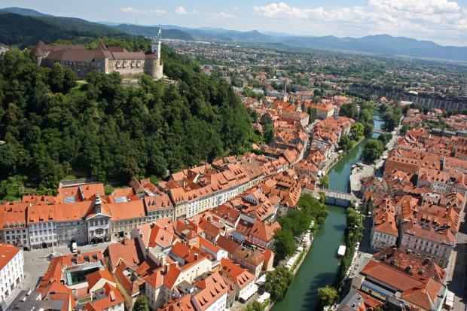
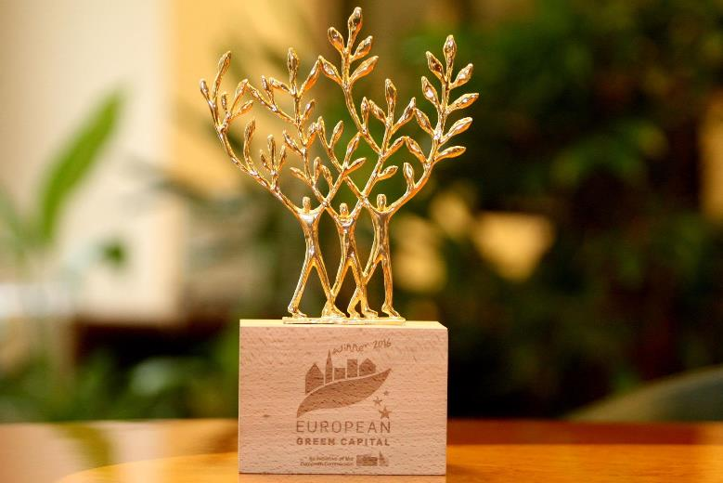
The City of Ljubljana
Ljubljana, the capital city of Slovenia and one of 11 Slovenia‘ city municipalities (all together 212 municipalities in the country)
https://www.youtube.com/watch?v=V8EySYYfV0c
European Green Capital 2016 winner
photo: Nik Rovan
photo: Primož Hieng, source: Tourism Ljubljana

Slide 8
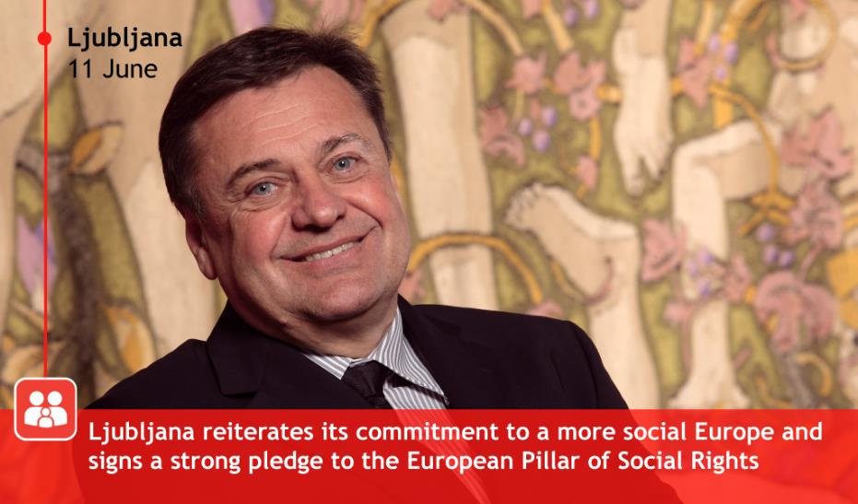
Stakeholders at improving accessibility in the City of Ljubljana
Mayor of The City of Ljubljana, who gives exceptional added value to the topic
active Mayoral advisory body discuss drafts of city‘s strategic documents (action plans and reports on their implementation)
City administration, city‘s public companies and institutes in charge of measures and tasks that need to be undertaken in accordance with city‘s strategic documents (action plans)
photo: EUROCITIES

Slide 9
How it is done…
Council for the Elimination of Architectural and Communication Barriers MOL – SOAKO
Action plan "Ljubljana - a municipality tailored to the disabled„
Project documentation revisions
Examples of implementation in nature

Slide 10
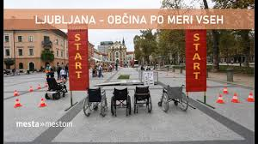
Ljubljana Council for the Removal of Architectural and Communication Barriers (SOAKO)
members - representatives of individual disability groups, architectural profession and the wider city administration
accessibility issues are addressed directly to policy makers in the city
no executive powers/ its conclusions are primarily of a recommendatory nature
an effective tool for the direct implementation of actions on the ground + for the formulation of appropriate policies in the city

Slide 11
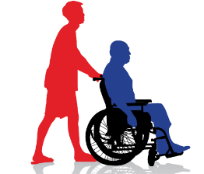
Ljubljana‘s action plans (AP) to improve accessibility
Ljubljana – Tailor made for People with Disabilities AP
INITIATIVE
first AP prepared as a part of activities within the national project ‚Municipality Tailor-made for People with Disabilities‘
STRUCTURE
around 100 measures/tasks in each two years AP
PREPARATION
every two years since 2008 – already sixth in progress (2008 – 2010, 2011 – 2012, 2013 – 2014, 2015 – 2016, 2017 – 2018, 2019 – 2020)
Action plan Ljubljana. Accessible to all (2021 – 2025)
collecting proposals for the new AP + data for the report on AP, which is to expired

Slide 12
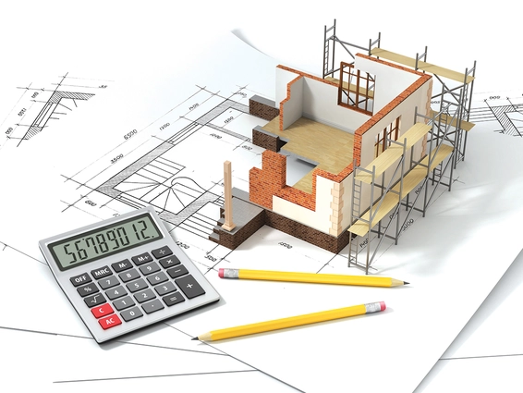
Ljubljana‘s action plans (AP) for disabled to improve accessibility
Project documentation revisions
Regular assignment
HOLDER
Office for Development Projects and Investments MU MOL, Department of Economic Activities and Transport MU MOL, Public Housing Fund MOL

Slide 13
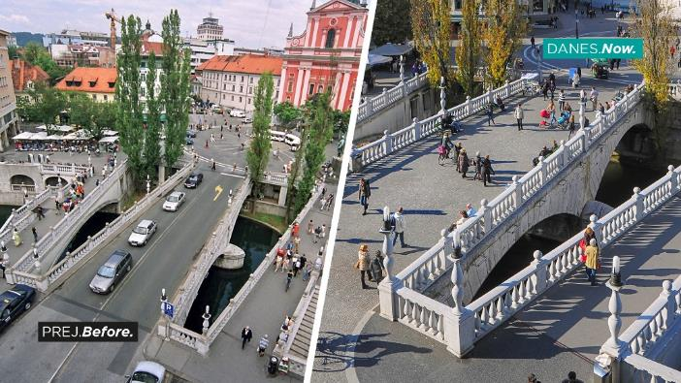
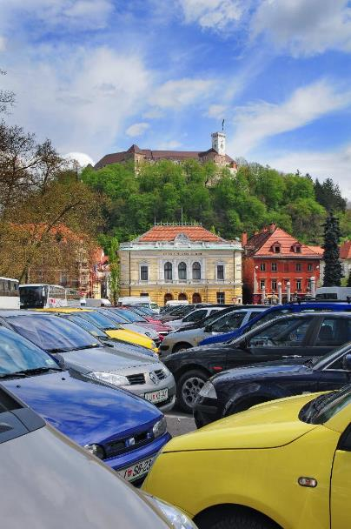
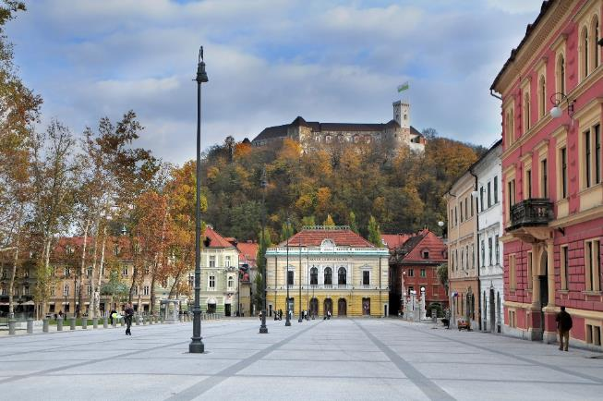
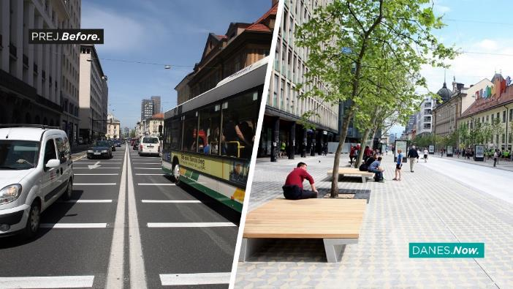
Overview of solutions
The Triple Bridge and Slovenska street before and now
Eco zone in the city centre
Congress Square before and now
photo: Dunja Wedam, source: Tourism Ljubljana
photo: Dunja Wedam
photos: Dunja Wedam, source: Tourism Ljubljana (above), Miha Fras, Nik Rovan, source: CoL (below)

Slide 14
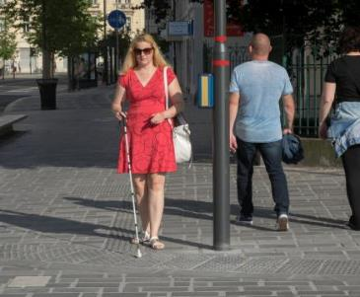
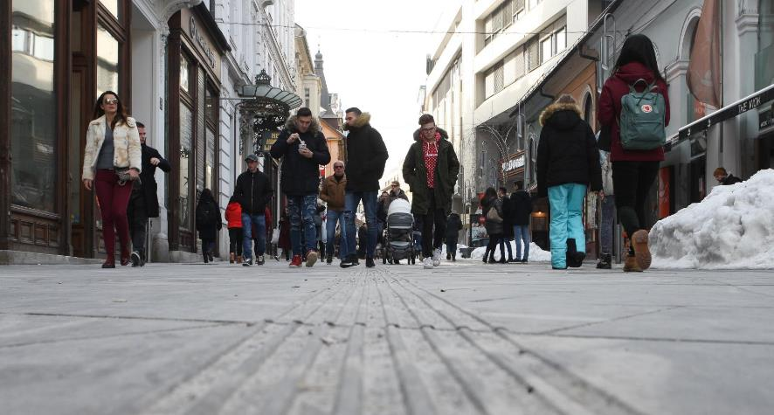
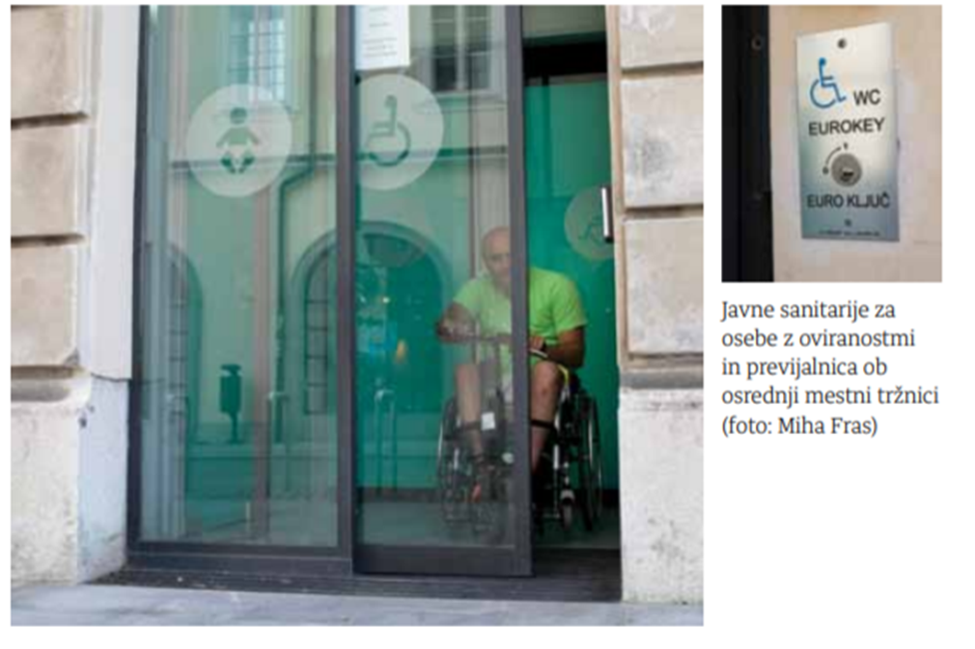
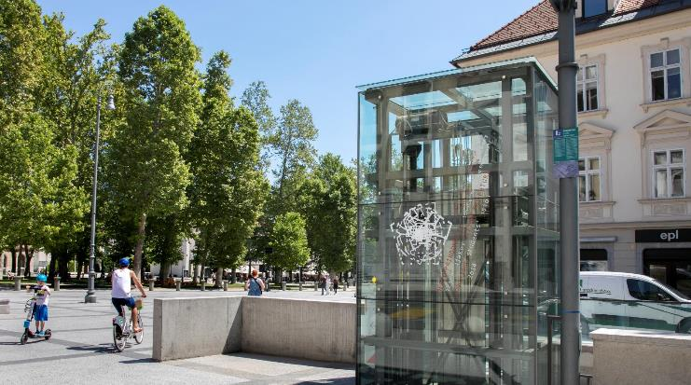
Tactile guiding paths and protruded grip floor warning markings at pedestrian crossings
photo: Nik Rovan
photos: Miha Fras
Lifts and accessible public toilets

Slide 15
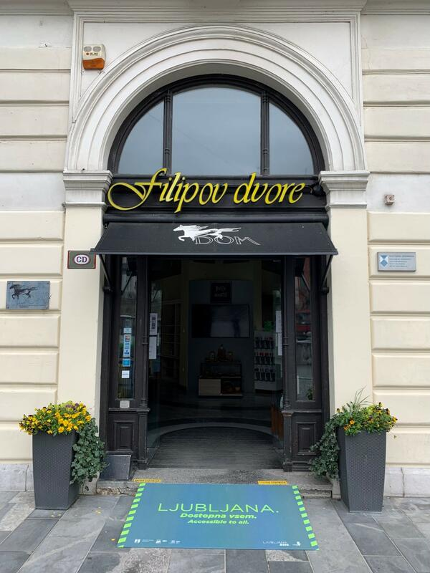
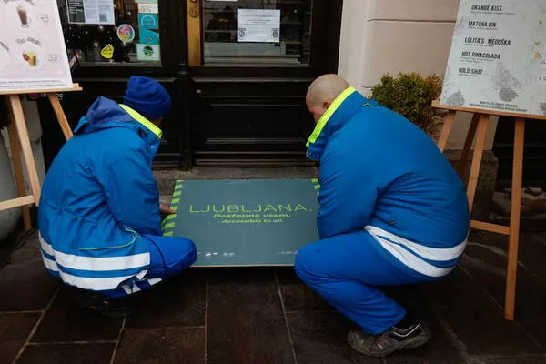
city's ramps to facilitate access to shops and places of business in the old city centre, which the City of Ljubljana owns

Slide 16
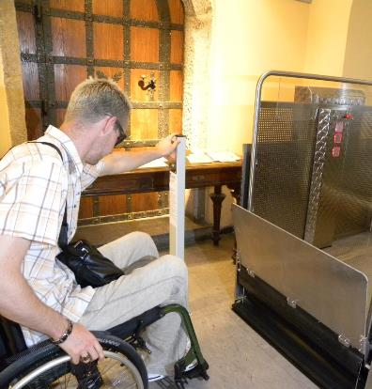
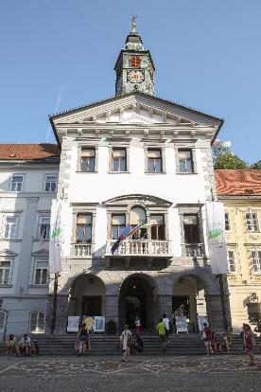
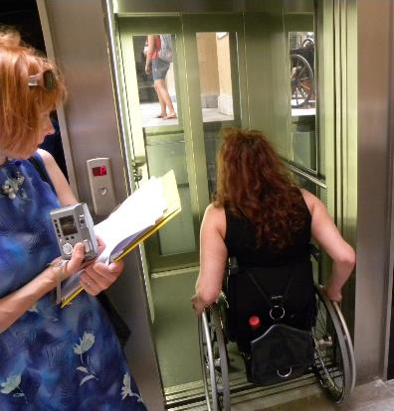
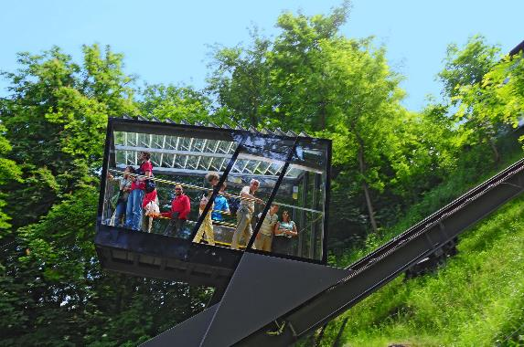
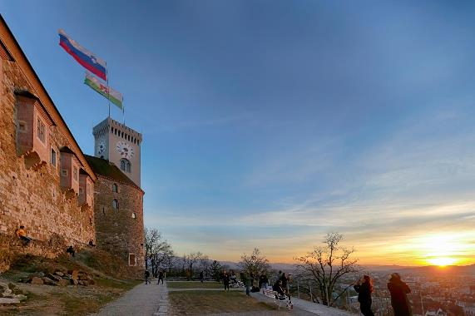
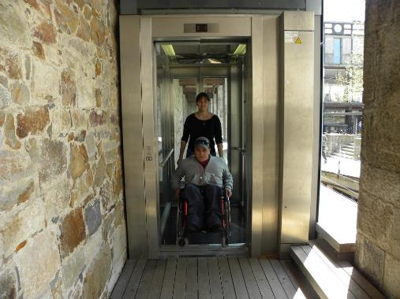
Build environment
Lifting platform and lift in the City Hall (above)
Funicular railway to Ljubljana Castle and lift at Ljubljana Castle to access the castle courtyard (bellow)
City Hall Photos: Association of Paraplegics of the Ljubljana Region archive (left and right), Nik Rovan (middle)
Ljubljana Castle Photos: Dunja Wedam, source: Tourism Ljubljana (left), Miha Mally (middle), Association of Paraplegics of the Ljubljana Region archive (right)

Slide 17
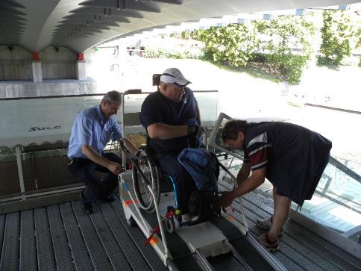
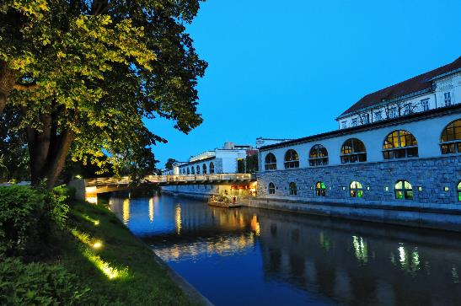
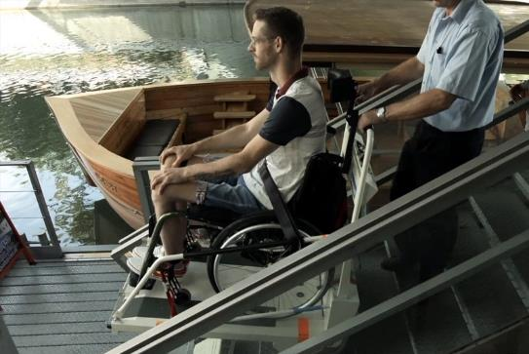
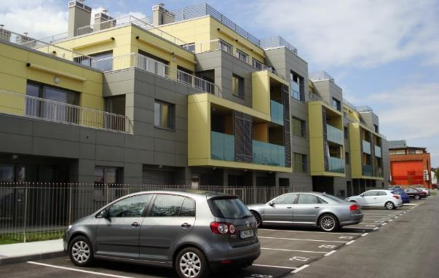
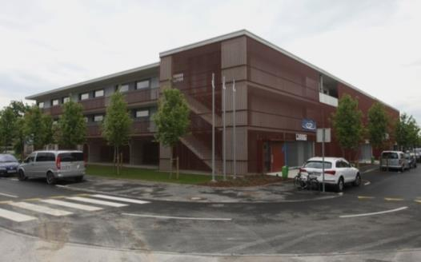
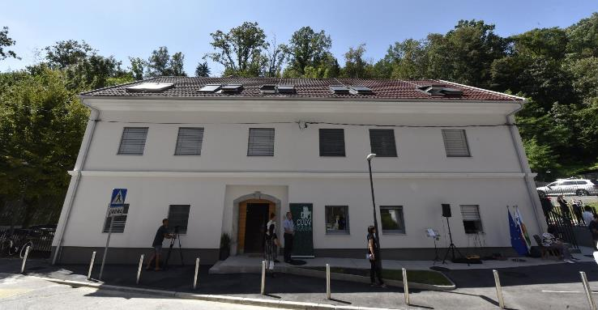
Access to boats on the River Ljubljanica below Butcher's Bridge via a stair lift
photos: Association of Paraplegics of the Ljubljana Region archive (left), Dunja Wedam, source: Tourism Ljubljana (middle), CoL archive (right)
City of Ljubljana Housing Fund‘s residental units/buildings
photos: City of Ljubljana Housing Fund archive (left and middle), Nik Rovan (right)

Slide 18
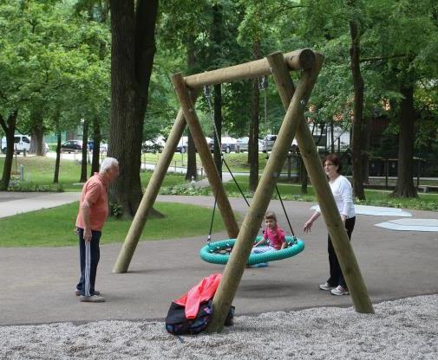
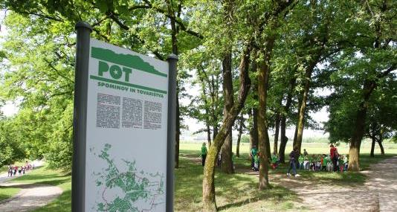
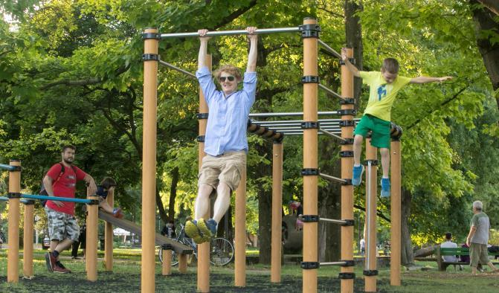
Public green areas
Out-door free to use (sports) facilities: children‘s playgrounds, outdoor fitness’s, street workout parks, recreational and trim trails
photos: Nik Rovan (above), Miha Fras (below)

Slide 19
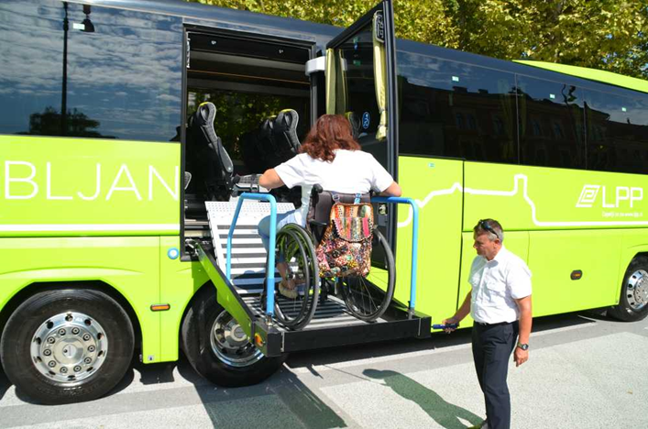
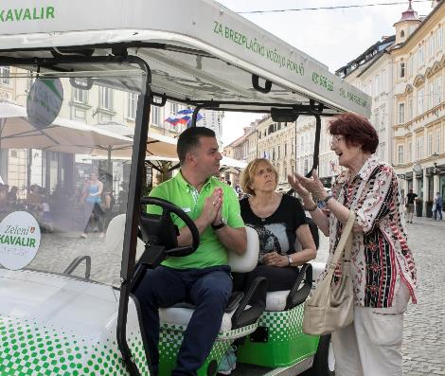
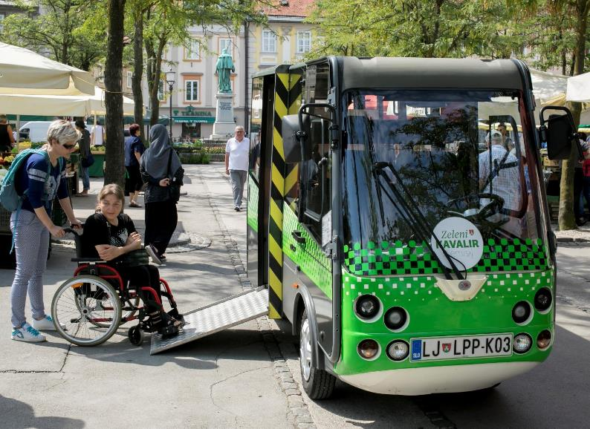
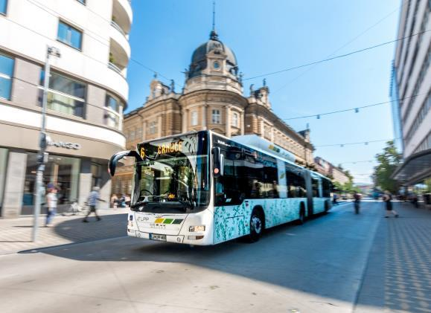
City‘s public transport
Low-floor buses
‚Kavalir‘ (Cavalier) electric vehicles for free rides in the city eco zone
Bus stops with screens showing arrivals
2 accessible tourist bus
photo: DP ljubljanske pokrajine
photo: Miha Fras
photo: Blaž Pogačar

Slide 20
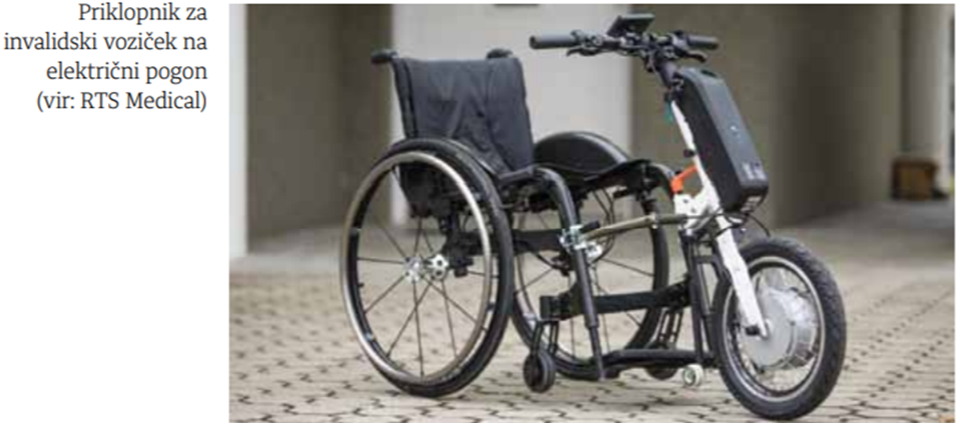
Transportation in the ecological zone - 2 wheelchair trailers available free of charge in the premises of JZ Turizem Ljubljana

Slide 21
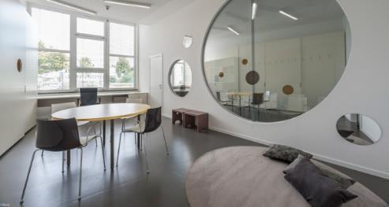
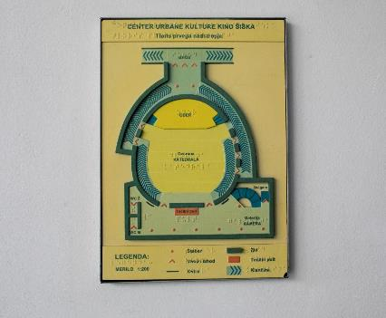
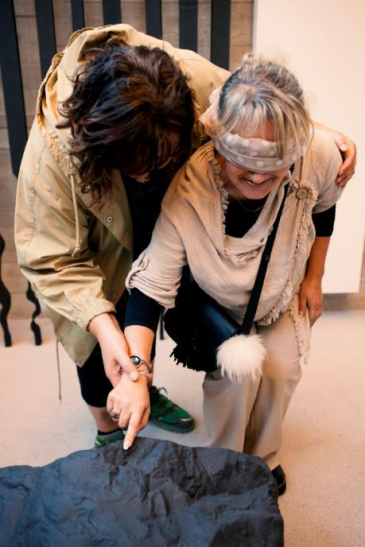
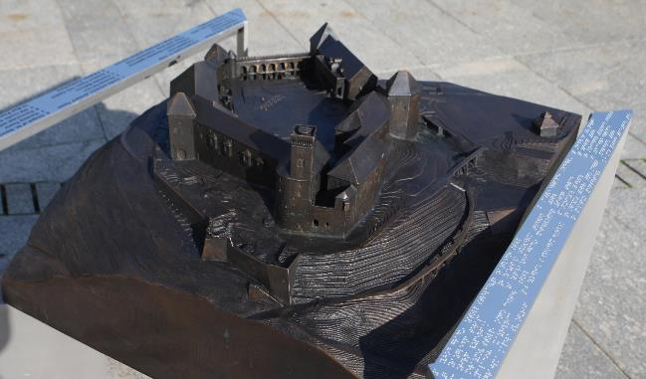
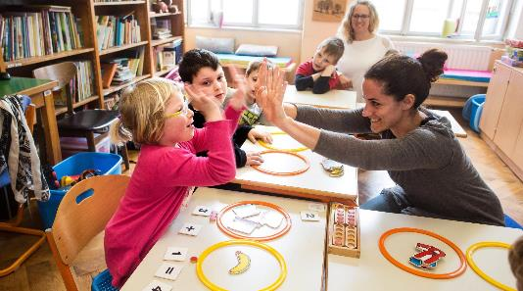
Services/programmes
Besides the obligatory duties set by laws, City co-finance diverse range of programmes and services for people with disabilities/ elderly through regular public tenders.
photos: Urška Boljkovač (left), Blaž Zupančič, source: Curk Architecture archive (above in the middle), Nada Žgank, source: Janez Levec Centre Ljubljana archive (below in the middle), Miha Fras (above on right), Nik Rovan (below on right)

Slide 22
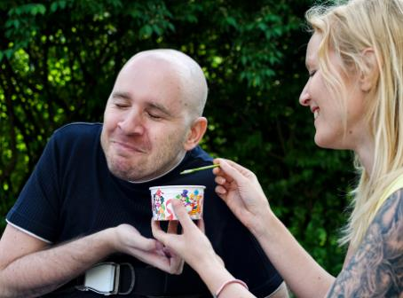
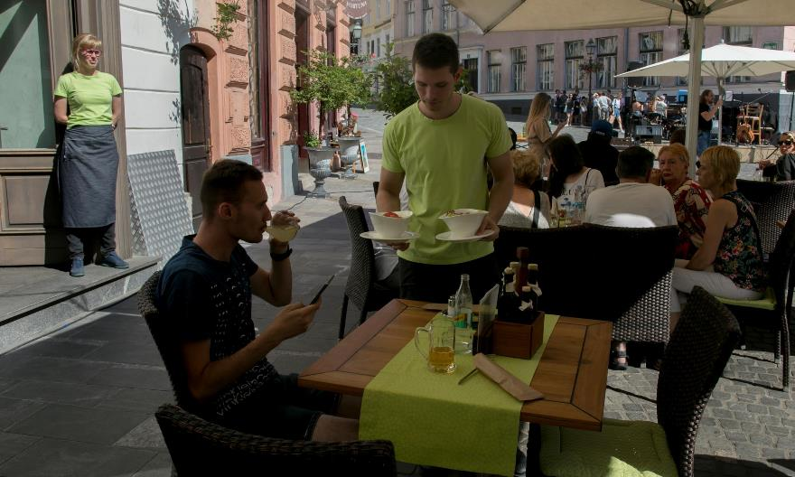
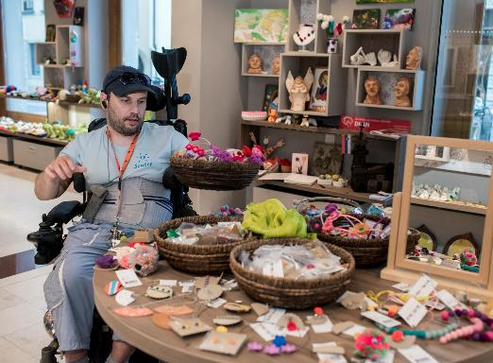
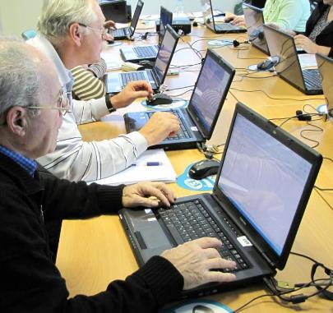
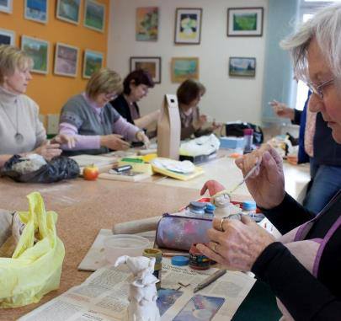

(photos: Miha Fras)
photos: Klaudija Poropat (above on left), Miha Fras (above on right, below on left, below the third), CoL Local Self-Government Office archive (below the second), Association of Paraplegics of the Ljubljana Region archive (below on right)

Slide 23



Information/communication
City’s official web page www.ljubljana.si complies with double »A« level of WAI’s WCAG 2.0 standard
City‘s Information point for people of the age 65+ and for people with disabilities operates in the city centre, near the City Hall
photos: Miha Fras

Slide 24



Awareness raising activities
OBSTICLEtlon (OVIRANtlon) implemented within the European Mobility Week each year since 2015
photos: Benjamin Kovač (above), Association of Paraplegics of the Ljubljana Region archive (below)

Slide 25



Ljubljana for all booklet with guidelines for the proper approach to and communication with people with disabilities
awareness raising media campaign on appropriate use of parking spaces, reserved for people with disabilities

Slide 26

Ljubljana by Wheelchair - wheelchair accessible locations in Ljubljana, Slovenia.

Slide 27

Results of systematic work and implemented solutions
accessibility is ever more integrated in a decision making and solution implementing process
awareness about people‘s special needs and social diversity is on the rise
user-friendly solutions contribute importantly towards social inclusion
CITY ADMINISTRATION began regulating the accessibility of the city ON IT'S OWN INITIATIVE, without any initiatives from citizens or representatives of individual groups of PWD.

Slide 28




Awards …
Green Destination PLATINUM badge
European Best Destination 2022
Ljubljana among the best food destinations in the world

Slide 29



Ljubljana wins the digitalisation award in the european capital of smart tourism 2020 competition
best congress destination in the category of cities hosting events for up to 2,000 people, 2020
2018, Ljubljana was declared the winner of the sustainable tourism award within the first European Capital of Smart Tourism competition.

Slide 30


t the Dragon's Ball, a recognition that contributes to the development of niche tourism and the introduction of excellent practices in respecting diversity.
Ljubljana won the so-called tourist Oscar for its excellent achievements in tourism development. The Golden Apple Award (La Pomme d'Or)

Slide 31

LJUBLJANA – An open and Accessible City
https://www.youtube.com/watch?v=l25Je0zpf8

Slide 32

Ljubljana – the most beautifull city in the world!
Thank you for your attention and wellcome to visit our city!

