Slide 1



Project:
Recruitment and Training Program of Unemployed Persons for the provision of home care services for People with Disabilities - SCI
Programme “THALIA 2021-2027”
Priority 11: Social Innovative Actions
Mr. Dimitris Lambrianides
President of the Board
CYPRUS
PARAPLEGICS
ORGANISATION
Respect
Dignity
Equality

Slide 2
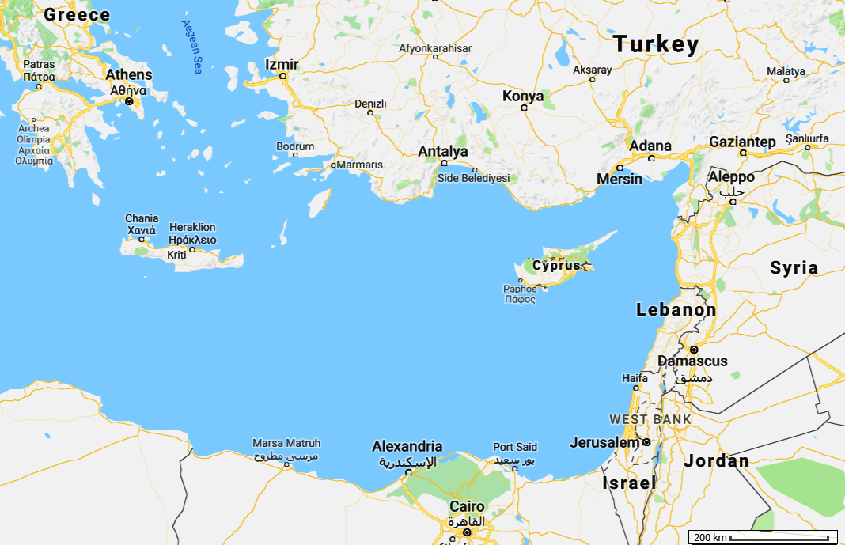

Slide 3
The project is under the Administration of the
CYPRUS PARAPLEGICS ORGANISATION (CPO)
    Cyprus Paraplegics Organization was founded in 1980 by persons with spinal cord injury.
    It’s the National Organization in Cyprus representing persons with SCI
    Has 250 members in a population of 920,000
    Independent living was on top of the agenda from day 1
    Member of the European Network of Independent Living
www.opak.org.cy

Slide 4
From Recipients of care benefits to providers of CARE/PA services
In 2017 during a meeting with the Minister of welfare of Cyprus, we presented the problems that our members were facing and asked for better support from the government in order to upgrade the personal assistant services provided to our members.
The Minister of Welfare proposed us to design and operate a personal assistant service where we would be the employers of the personnel with the total cost of employer covered by European funds. This would be offered without any reduction to benefits that we were already eligible.
www.opak.org.cy

Slide 5
From Recipients of care benefits to providers of CARE/PA services 2/2
Acknowledging the high cost of such services the Minister approved 100% funding by the EU through schemes targeting unemployment.
The only term was to employ unemployed individuals and train them according to our special needs.
The project started: 01.01.2018
It evolves continuously by increasing and upgrading provided services
www.opak.org.cy

Slide 6
From idea to reality
The proposal we had in front of us was
too good to ignore
although it would create serious responsibilities to our organization since we would become employer and provider of the services.
However we would have total control of the program.

Slide 7
From idea to reality 2/2
With collaboration with different government departments we started designing the program, starting with:
  Terms of employment
  Training program/material and trainers with relevant specialization
  Searching for unemployed persons who would be interested for this job country wide
  Contacting our members to identify who were interested to start receiving services as soon as we were ready
  Identifying the methods that we would use to check that services were delivered smoothly
  Designing the method and system for record keeping of time shifts

Slide 8
History of access to care services in Cyprus
Early 2000s - Our organization persuaded the government to establish benefits for purchasing care services in Cyprus.
Care benefit for paraplegics and tetraplegics is provided to all persons with SCI in Cyprus with NO income-criteria.
Paraplegics € 400/month
Paraplegics with neurogenic bowel/bladder € 500/month
Tetraplegics € 900/month
Tetraplegics with respirator and/or neurogenic bowel/bladder € 1100/month

Slide 9
History of access to care services in Cyprus 2/2
Until recently care or personal assistant services were provided by domestic workers from third countries, unskilled and often not truly willing to work as a carer/personal assistant.
Locally care services were/are provided by private companies that employ nurses but cost is prohibitive.

Slide 10
Challenges that led to the design of the project
  The dependence of persons with SCI on
    1.family members which causes psychological distress
    2.Unskilled carers from third countries
    Often such personnel abandoned the paraplegic/tetraplegic employer preferring to work as a house cleaner or old person carer with lighter duties
  The risk of institutionalization
  The high cost of services by private companies
  The increased rate of unemployment in Cyprus

Slide 11
Main Scope
Offering Home Care Services +
Personal
Assistance
    Offering services to people with SCI to improve quality of their life and to live independently.
      Persons with paraplegia and tetraplegia after spinal cord injury
      Exp. to persons with muscular dystrophy
      Future plans to cover more PwD
    Provide high quality personal care [toileting/bathing] for persons whom their disability causes bowel and bladder complications that need special care.

Slide 12
Basic Policies
A Social Worker in collaboration with a nurse are using an evaluation tool in order to estimate the needs of each interested member
We plan to staff the team with an OT [Occupational Therapist] as well
Paraplegics are eligible for 3hrs/day and Tetraplegics 6hrs/day, in special cases duration can be increased

Slide 13
Basic Policies
No age restriction for members to apply and receive services
The service is not offered as a primary care option but supportive to the adjustments of our members
We employ 2nd degree relatives but not as personal carer/assistant of the relative

Slide 14
Supplementary Scope/
Work opportunities
    Created a new profession in Cyprus.
    Training material was according to our needs and demands and we can monitor the training.
    Provides job opportunities to unemployed people even to people who did not graduate secondary education.
    Starting salary is €1.300/month while minimum salary by law in Cyprus is €940/month

Slide 15
Supplementary Scope/
Work opportunities
    The family members of persons with SCI can be employed elsewhere since their relative is not anymore fully dependent on them or can enjoy more personal time.
The program/project has reduced the dependence on personnel from third-countries while, at the same time, providing employment opportunities to residents of Cyprus /European citizens.

Slide 16
Main Scope
Inclusion
    Utilization of the service by persons with SCI to increase the opportunities of participation in various aspects of life including:
      Social
      Cultural
      Sports and Leisure
      Healthcare services
      Education
    Facilitate access in various services

Slide 17
Focus of the project- Actions
  Provision of specialized and continuous staff training.
  Provision of nursing, personal care and escorting
  Provision of counseling and psychological support by Health Care professionals (Clinical Psychologist, Social Workers).
  Continuous monitoring of the level of satisfaction of services recipients and corresponding reforms/actions to maintain or improve the provided services.

Slide 18
Output and Result Indicators until 2025
Estimated figures until 2025:
  Total expected employment of 94 Care Workers
  Total expected provision of services for
  110 Care Recipients

Slide 19


2023 data in numbers
Care providers 83 (24 men)
Care recipients 87
More than 135,000 hours of services will be provided
Cost more than €1.8m

Slide 20

Some comments by users
CYPRUS
PARAPLEGICS
ORGANISATION
Respect
Dignity
Equality

